Slide 1
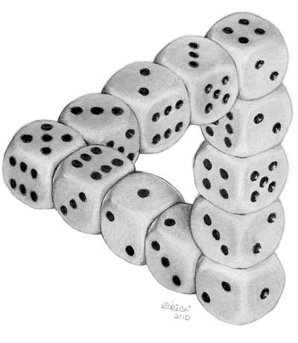

Better Pseudodistributions and Derandomization for Space-Bounded Computation
Oxford-Warwick Complexity Meeting
July 1, 2021
William M. Hoza
UT Austin $→$ Simons Institute
“Dice Illusion” by DeviantArt user Moko-m. (License: CC BY-NC-ND 3.0)
Supported by the NSF GRFP under Grant DGE-1610403 and by a Harrington Fellowship from UT Austin.

Slide 2
😢
🙂
😄
No known efficient algorithm
Efficient randomized algorithm
Efficient deterministic algorithm

Slide 3
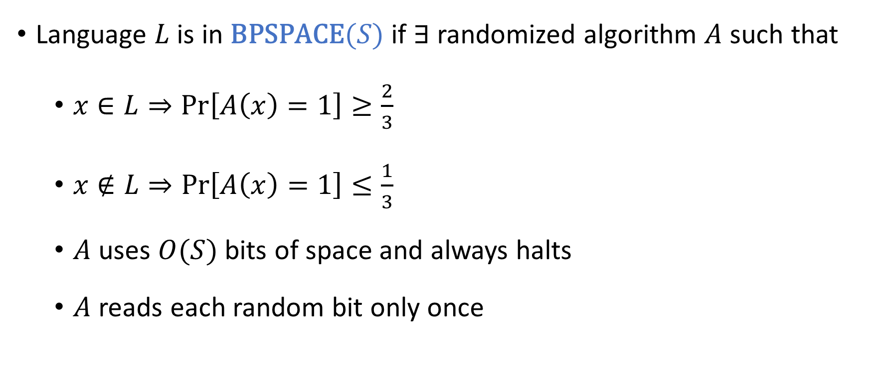
Randomized space-bounded algorithms
Language $L$ is in $\text{BPSPACE}(S)$ if $∃$ randomized algorithm $A$ such that
$x∈L⇒\text{Pr}\left[A\left(x\right)=1\right]≥\frac{2}{3}$
$x∉L⇒\text{Pr}\left[A\left(x\right)=1\right]≤\frac{1}{3}$
$A$ uses $O(S)$ bits of space and always halts
$A$ reads each random bit only once

Slide 4



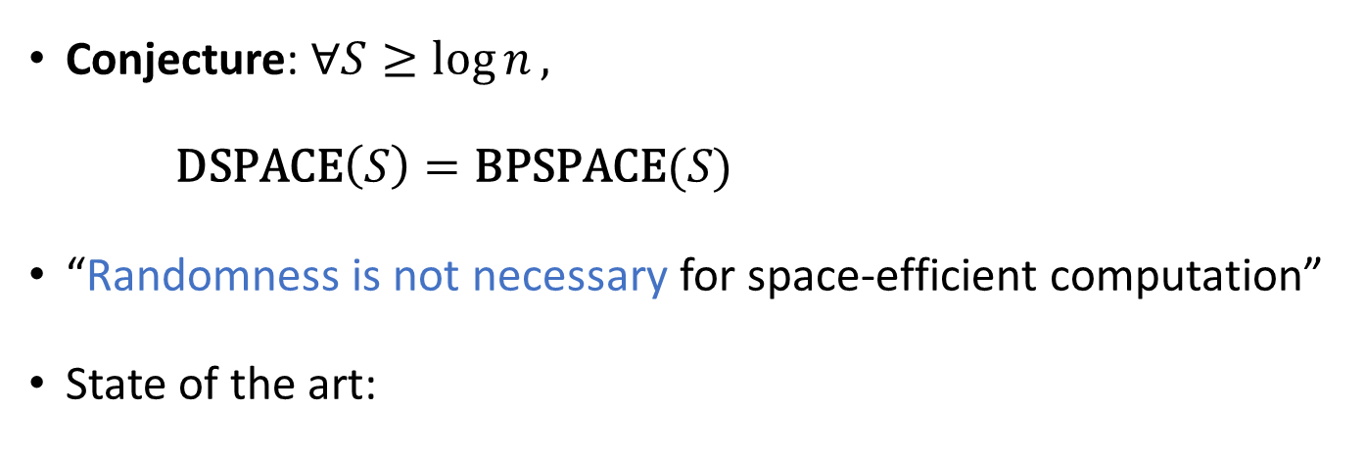
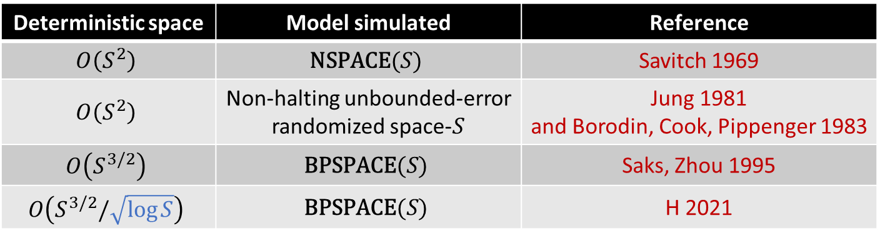
Power of randomness?
Conjecture: $∀S≥\log{n},$
$\text{DSPACE}\left(S\right)=\text{BPSPACE}(S)$
“Randomness is not necessary for space-efficient computation”
State of the art:
Deterministic space | Model simulated | Reference
$$O\left(S^{2}\right)$$ | $$\text{NSPACE}(S)$$ | Savitch 1969
$$O\left(S^{2}\right)$$ | Non-halting unbounded-error randomized space-$S$ | Jung 1981 and Borodin, Cook, Pippenger 1983
$$O\left(S^{3/2}\right)$$ | $$\text{BPSPACE}(S)$$ | Saks, Zhou 1995
$$O\left(S^{3/2}/\sqrt{\log{S}}\right)$$ | $$\text{BPSPACE}(S)$$ | H 2021

Slide 5
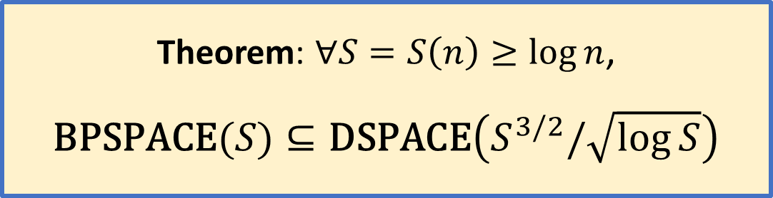

Better derandomization of $\text{BPSPACE}$
Theorem: $∀S=S\left(n\right)≥\log{n}$,
$$\text{BPSPACE}(S)⊆\text{DSPACE}\left(S^{3/2}/\sqrt{\log{S}}\right)$$
Key ingredient of proof: weighted pseudorandom generators (WPRGs)
Aka pseudorandom pseudodistribution generators
Main topic of today’s talk
Maybe someday WPRGs will yield a bigger payoff
Also, WPRGs are interesting in their own right

Slide 6
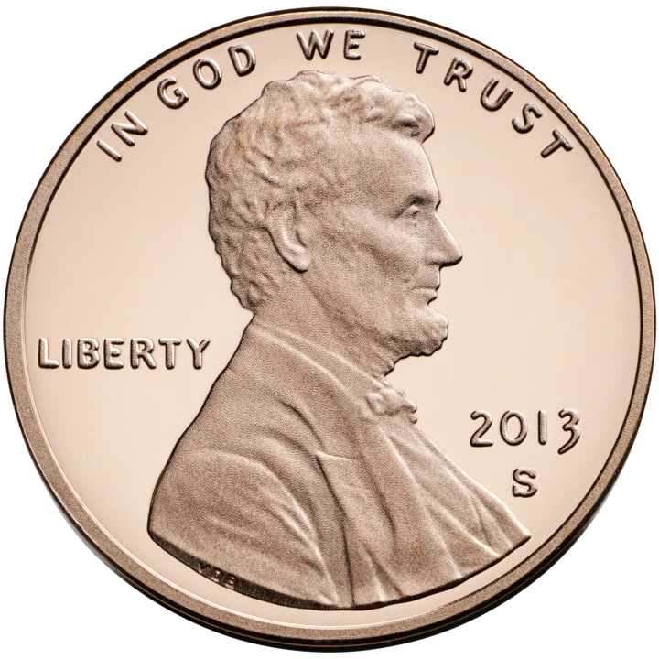

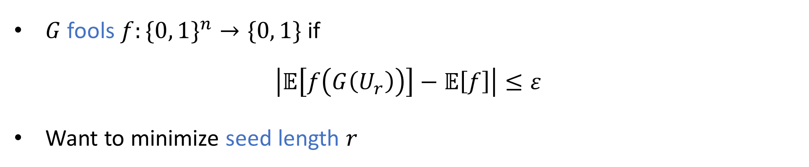
Pseudorandom generators (PRGs)
$G:\{0, 1\}^{r}→\{0, 1\}^{n}$
$G$ fools $f:\{0, 1\}^{n}→\{0, 1\}$ if
$$\left|𝔼\left[f\left(G\left(U_{r}\right)\right)\right]−𝔼\left[f\right]\right|≤ε$$
Want to minimize seed length $r$

Slide 7
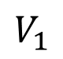

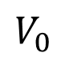
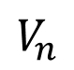
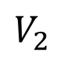
Read-once branching programs (ROBPs)
$$x=$$
$$1$$
$$0$$
$$0$$
$$1$$
$$0$$
$$1$$
0
1
$$v_{\text{acc}}$$
$$v_{\text{start}}$$
1
0
1
Computes
$$f:\{0, 1\}^{n}→\{0, 1\}$$
Width
0
1
1
0
0
0
1
$$V_{0}$$
$$V_{1}$$
$$V_{2}$$
$$⋯$$
$$V_{n}$$

Slide 8
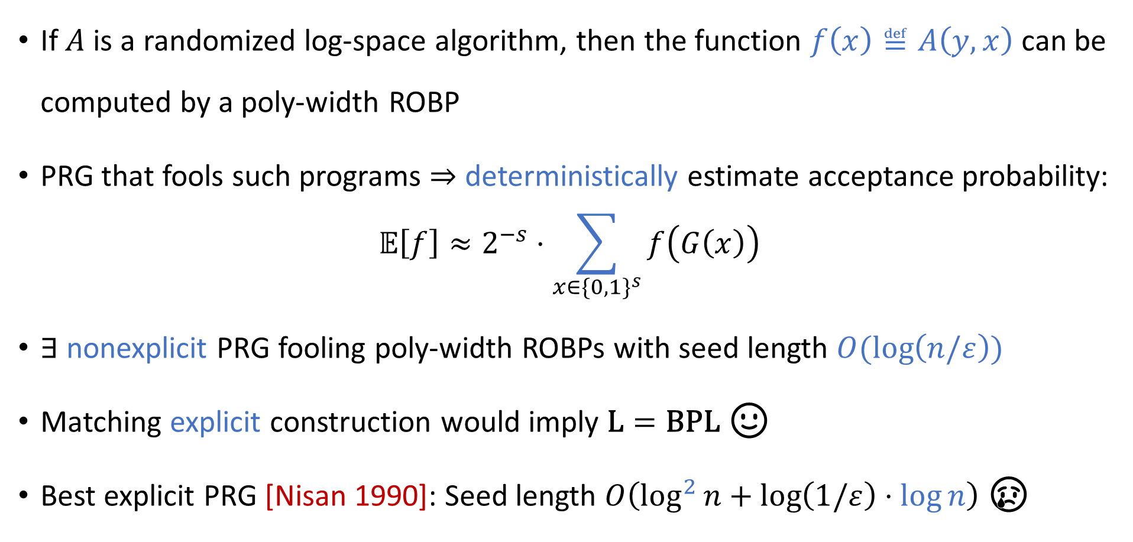
Using PRGs for derandomization
If $A$ is a randomized log-space algorithm, then the function $f\left(x\right)≝A\left(y,x\right)$ can be computed by a poly-width ROBP
PRG that fools such programs $⇒$ deterministically estimate acceptance probability:
$$𝔼\left[f\right]≈2^{−s}⋅\sum_{x∈\{0, 1\}^{s}}{f\left(G\left(x\right)\right)}$$
$∃$ nonexplicit PRG fooling poly-width ROBPs with seed length $O(\log\left(n/ε\right))$
Matching explicit construction would imply $\text{L}=\text{BPL}$ 🙂
Best explicit PRG [Nisan 1990]: Seed length $O\left(\log^{2}{n}+\log\left(1/ε\right)⋅\log{n}\right)$ 😢

Slide 9
Derandomization without PRGs
Constructing good explicit PRGs is challenging ☹
But PRGs are not the only approach to derandomization 🙂
That’s why we study relaxations of the PRG concept
Hopefully, “generalized PRGs” are
Easier to construct
Still useful for derandomization

Slide 10
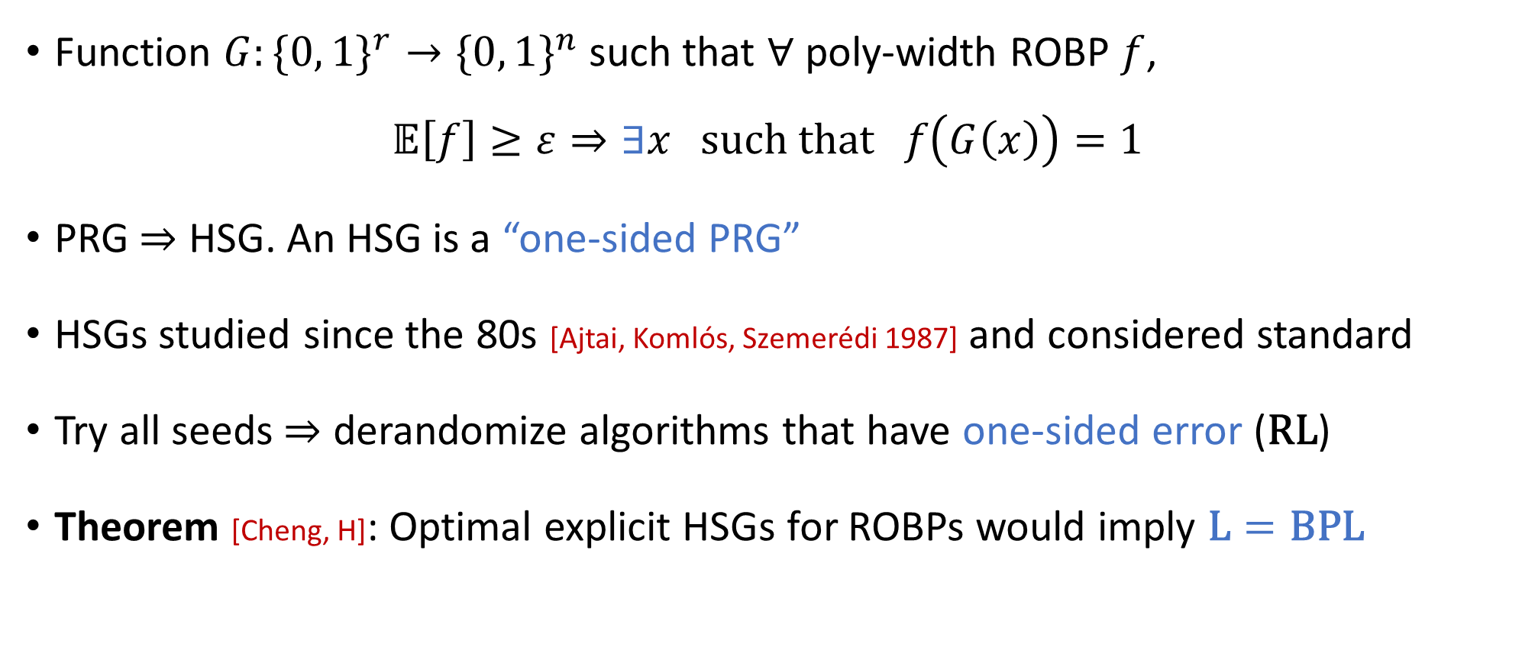
Hitting set generators (HSGs)
Function $G:\{0, 1\}^{r}→\{0, 1\}^{n}$ such that $∀$ poly-width ROBP $f$, $𝔼\left[f\right]≥ε⇒∃x \text{such} \text{that} f\left(G\left(x\right)\right)=1$
PRG $⇒$ HSG. An HSG is a “one-sided PRG”
HSGs studied since the 80s [Ajtai, Komlós, Szemerédi 1987] and considered standard
Try all seeds $⇒$ derandomize algorithms that have one-sided error ($\text{RL}$)
Theorem [Cheng, H]: Optimal explicit HSGs for ROBPs would imply $\text{L}=\text{BPL}$

Slide 11
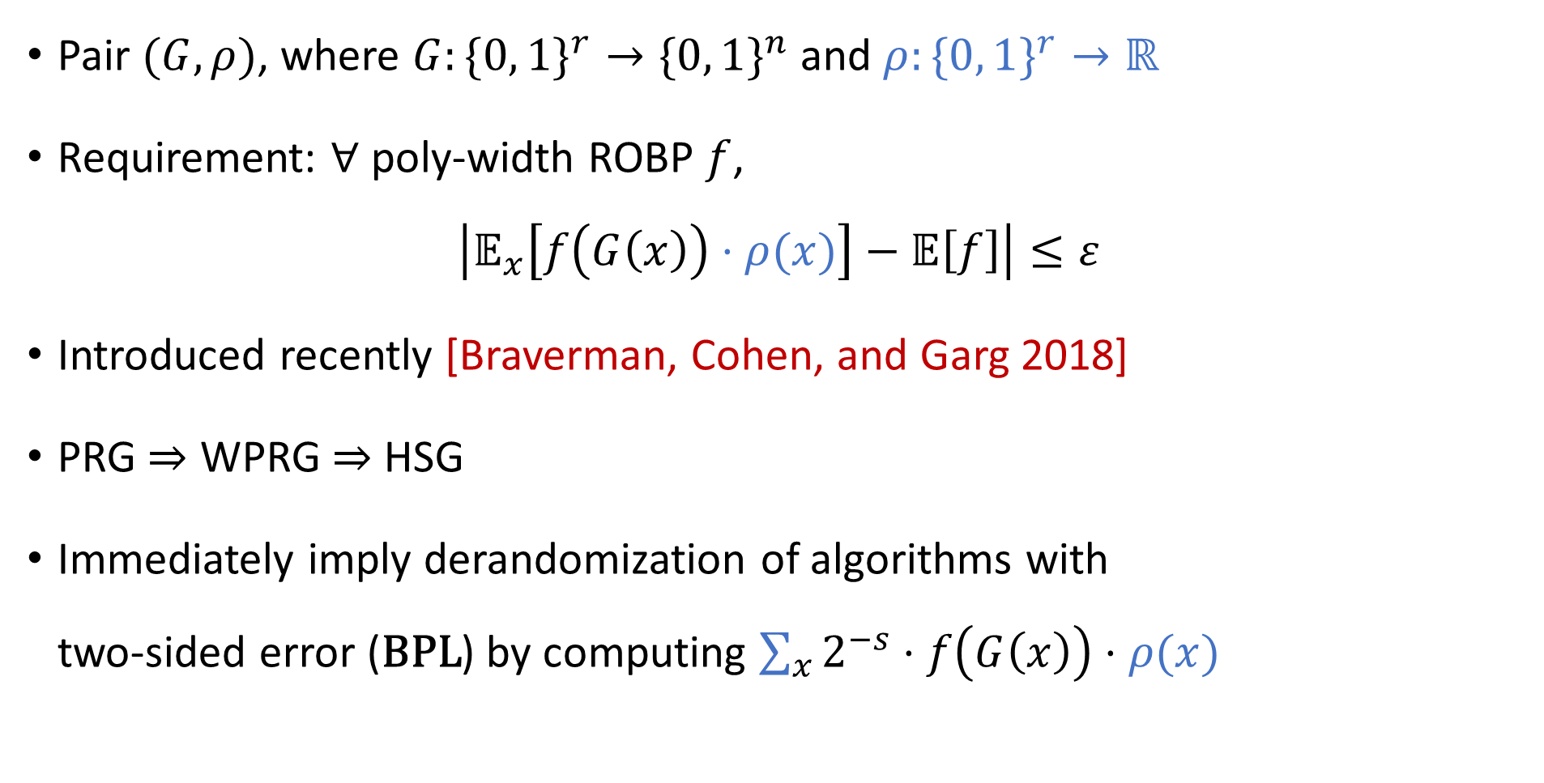
Weighted pseudorandom generators (WPRGs)
Pair $(G, ρ)$, where $G:\{0, 1\}^{r}→\{0, 1\}^{n}$ and $ρ:\{0, 1\}^{r}→ℝ$
Requirement: $∀$ poly-width ROBP $f$,
$$\left|𝔼_{x}\left[f\left(G\left(x\right)\right)⋅ρ(x)\right]−𝔼\left[f\right]\right|≤ε$$
Introduced recently [Braverman, Cohen, and Garg 2018]
PRG $⇒$ WPRG $⇒$ HSG
Immediately imply derandomization of algorithms with two-sided error ($\text{BPL}$) by computing $\sum_{x}{2^{−s}⋅f\left(G\left(x\right)\right)⋅ρ(x)}$
HSG
WPRG
PRG

Slide 12
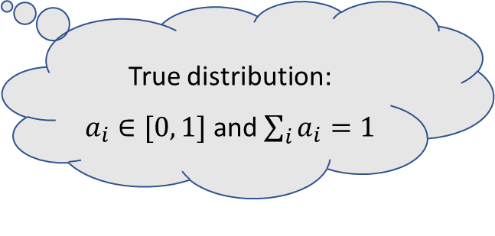
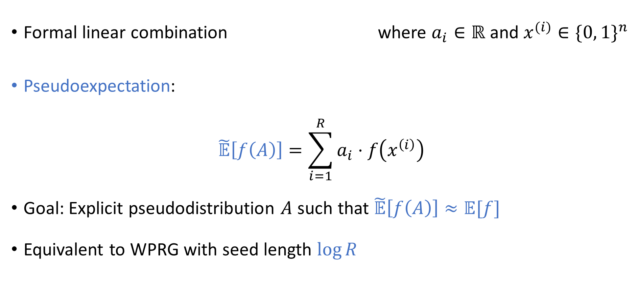
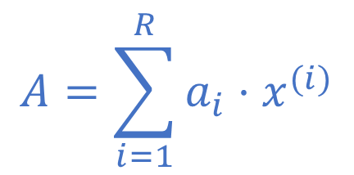
Alternative formalism: Pseudodistributions
“Pseudoprobability”
$$A=\sum_{i=1}^{R}{a_{i}⋅x^{(i)}}$$
Formal linear combination where $a_{i}∈ℝ$ and $x^{(i)}∈\{0, 1\}^{n}$
Pseudoexpectation:
$$\tilde{𝔼}\left[f\left(A\right)\right]=\sum_{i=1}^{R}{a_{i}⋅f\left(x^{\left(i\right)}\right)}$$
Goal: Explicit pseudodistribution $A$ such that $\tilde{𝔼}\left[f\left(A\right)\right]≈𝔼[f]$
Equivalent to WPRG with seed length $\log{R}$
True distribution: $a_{i}∈[0, 1]$ and $\sum_{i}{a_{i}}=1$

Slide 13
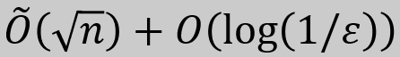
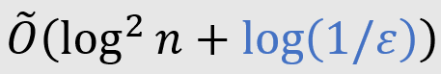
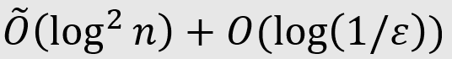
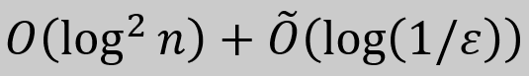

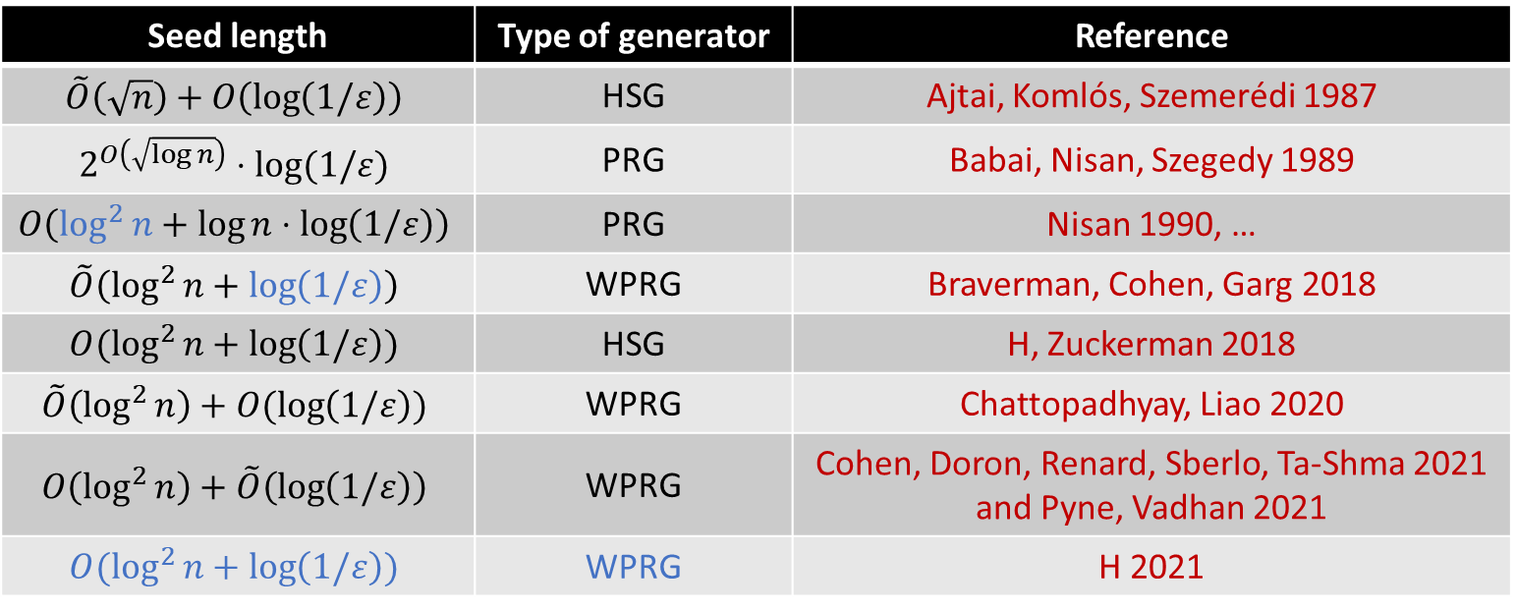

Generators for width-$n$ length-$n$ ROBPs
Seed length | Type of generator | Reference
$$\tilde{O}\left(\sqrt{n}\right)+O\left(\log\left(1/ε\right)\right)$$ | HSG | Ajtai, Komlós, Szemerédi 1987
$$2^{O\left(\sqrt{\log{n}}\right)}⋅log⁡(1/ε)$$ | PRG | Babai, Nisan, Szegedy 1989
$$O\left(\log^{2}{n}+\log{n}⋅\log\left(1/ε\right)\right)$$ | PRG | Nisan 1990, …
$$\tilde{O}\left(\log^{2}{n}+\log\left(1/ε\right)\right)$$ | WPRG | Braverman, Cohen, Garg 2018
$$O(\log^{2}{n}+\log\left(1/ε\right))$$ | HSG | H, Zuckerman 2018
$$\tilde{O}\left(\log^{2}{n}\right)+O(\log\left(1/ε\right))$$ | WPRG | Chattopadhyay, Liao 2020
$$O\left(\log^{2}{n}\right)+\tilde{O}\left(\log\left(1/ε\right)\right)$$ | WPRG | Cohen, Doron, Renard, Sberlo, Ta-Shma 2021 and Pyne, Vadhan 2021
$$O(\log^{2}{n}+\log\left(1/ε\right))$$ | WPRG | H 2021
Theorem: $∃$ explicit WPRG for width-$n$ length-$n$ ROBPs with seed length
$$O\left(\log^{2}{n}+\log\left(1/ε\right)\right)$$

Slide 14
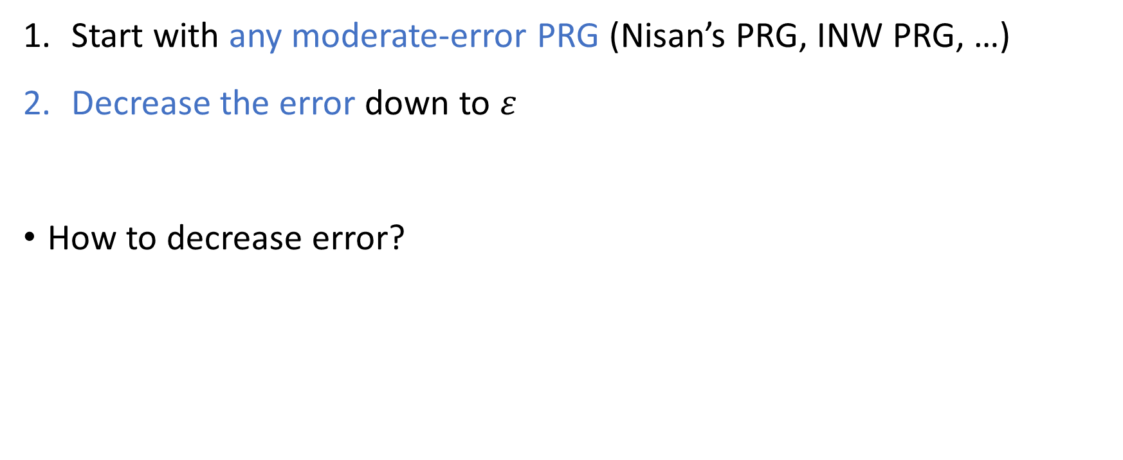
WPRG construction outline
Start with any moderate-error PRG (Nisan’s PRG, INW PRG, …)
Decrease the error down to $ε$
How to decrease error?

Slide 15

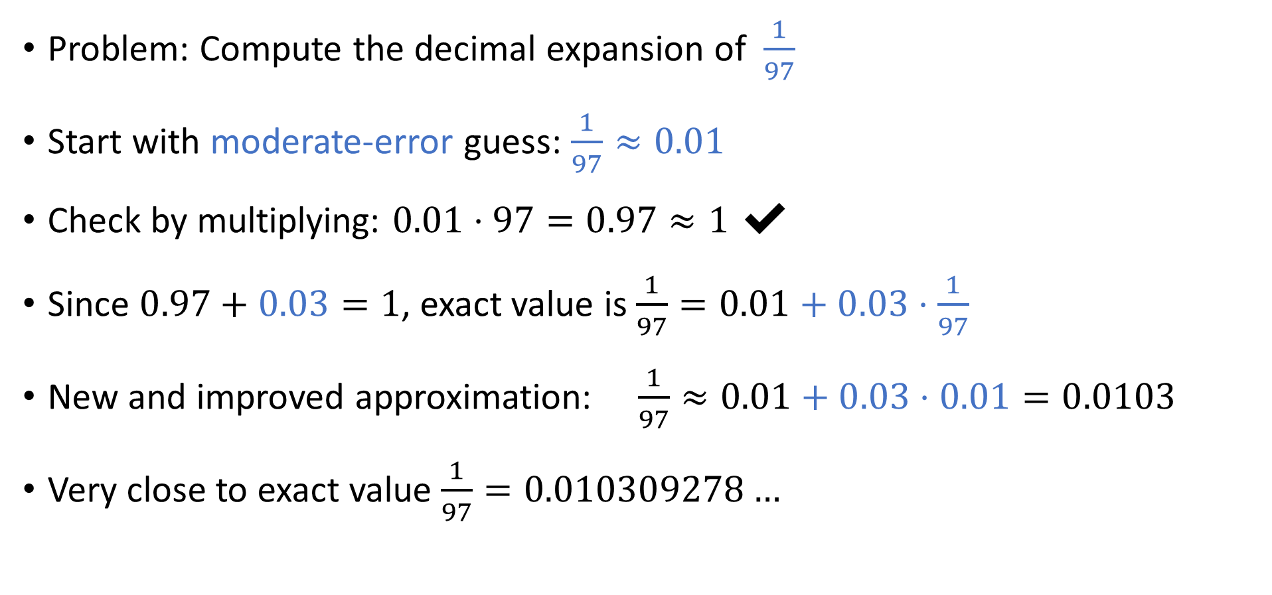
Warm-up 1: Fractions
Problem: Compute the decimal expansion of $\frac{1}{97}$
Start with moderate-error guess: $\frac{1}{97}≈0.01$
Check by multiplying: $0.01⋅97=0.97≈1$ ✔
Since $0.97+0.03=1$, exact value is $\frac{1}{97}=0.01+0.03⋅\frac{1}{97}$
New and improved approximation: $\frac{1}{97}≈0.01+0.03⋅0.01=0.0103$
Very close to exact value $\frac{1}{97}=0.010309278…$
🥚
🐔

Slide 16
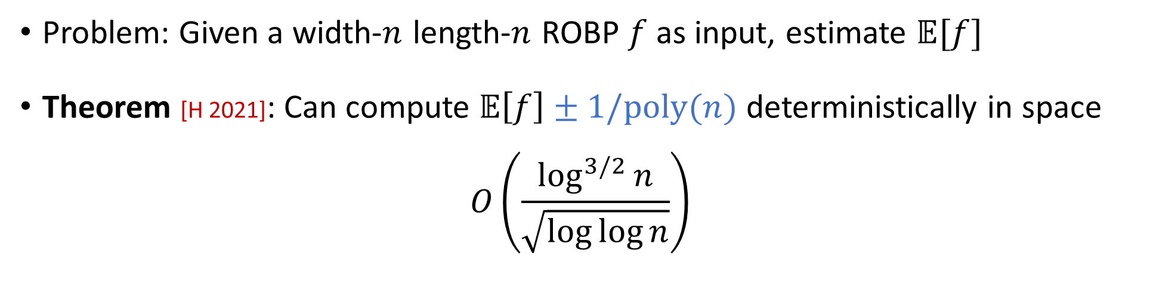

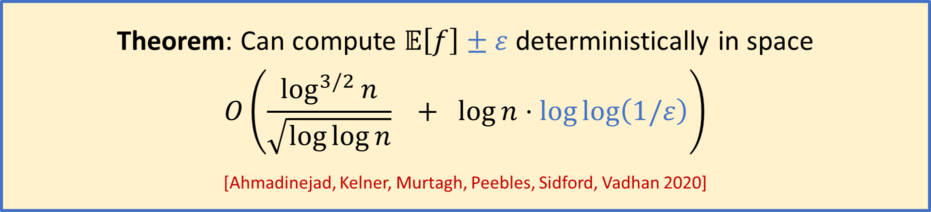
Warm-up 2: The role of $ε$ in the non-black-box setting
Problem: Given a width-$n$ length-$n$ ROBP $f$ as input, estimate $𝔼[f]$
Theorem [H 2021]: Can compute $𝔼\left[f\right]±1/\text{poly}(n)$ deterministically in space
$$O\left(\frac{\log^{3/2}{n}}{\sqrt{\log{\log{n}}}}\right)$$
Take this for granted for now
Theorem: Can compute $𝔼\left[f\right]±ε$ deterministically in space
$$O\left(\frac{\log^{3/2}{n}}{\sqrt{\log{\log{n}}}} + \log{n}⋅\log{\log\left(1/ε\right)}\right)$$
[Ahmadinejad, Kelner, Murtagh, Peebles, Sidford, Vadhan 2020]

Slide 17

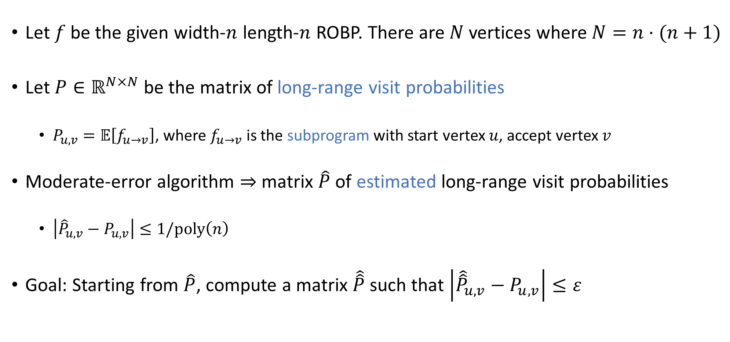
Matrix of probability estimates
Let $f$ be the given width-$n$ length-$n$ ROBP. There are $N$ vertices where $N=n⋅(n+1)$
Let $P∈ℝ^{N×N}$ be the matrix of long-range visit probabilities
$P_{u,v}=𝔼\left[f_{u→v}\right]$, where $f_{u→v}$ is the subprogram with start vertex $u$, accept vertex $v$
Moderate-error algorithm $⇒$ matrix $\hat{P}$ of estimated long-range visit probabilities
$\left|{\hat{P}}_{u,v}−P_{u,v}\right|≤1/\text{poly}\left(n\right)$
Goal: Starting from $\hat{P}$, compute a matrix $\hat{\hat{P}}$such that $\left|{\hat{\hat{P}}}_{u,v}−P_{u,v}\right|≤ε$
One entry is $𝔼[f]$

Slide 18
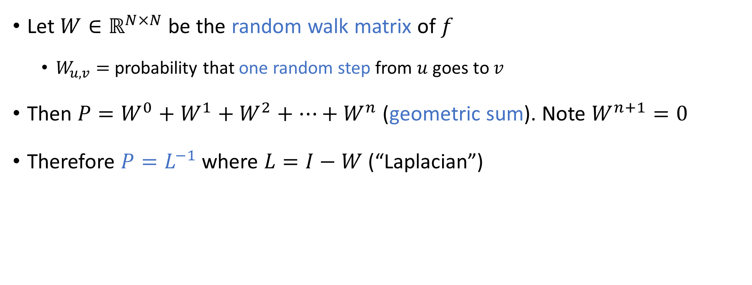
Inverse Laplacian perspective
[Ahmadinejad, Kelner, Murtagh,
Peebles, Sidford, Vadhan 2020]
Easy to compute
Let $W∈ℝ^{N×N}$ be the random walk matrix of $f$
$W_{u,v}=$ probability that one random step from $u$ goes to $v$
Then $P=W^{0}+W^{1}+W^{2}+⋯+W^{n}$ (geometric sum). Note $W^{n+1}=0$
Therefore $P=L^{−1}$ where $L=I−W$ (“Laplacian”)

Slide 19
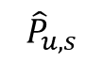

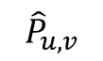
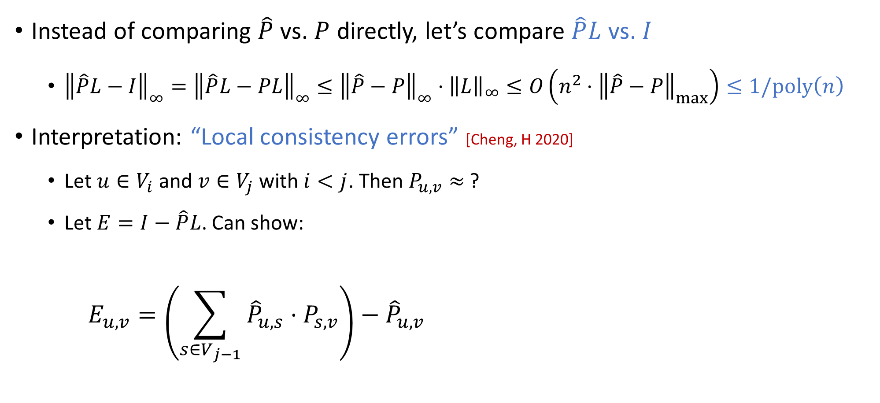

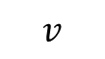
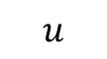
Alternative way of quantifying error
Instead of comparing $\hat{P}$ vs. $P$ directly, let’s compare $\hat{P}L$ vs. $I$
${\left\|\hat{P}L−I\right\|}_{∞}={\left\|\hat{P}L−PL\right\|}_{∞}≤{\left\|\hat{P}−P\right\|}_{∞}⋅{\left\|L\right\|}_{∞}≤O\left(n^{2}⋅{\left\|\hat{P}−P\right\|}_{max}\right)≤1/\text{poly}\left(n\right)$
Interpretation: “Local consistency errors” [Cheng, H 2020]
Let $u∈V_{i}$ and $v∈V_{j}$ with $i<j$. Then $P_{u,v}≈$ ?
Let $E=I−\hat{P}L$. Can show:
$$E_{u,v}=\left(\sum_{s∈V_{j−1}}{{\hat{P}}_{u,s}⋅P_{s,v}}\right)−{\hat{P}}_{u,v}$$
$${\hat{P}}_{u,s}$$
$${\hat{P}}_{u,v}$$
$$v$$
0.4
0.49
$≈$ 0.5 ✔
$$u$$
$$⋯$$
0.5
0.1

Slide 20

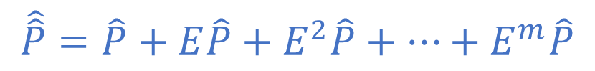
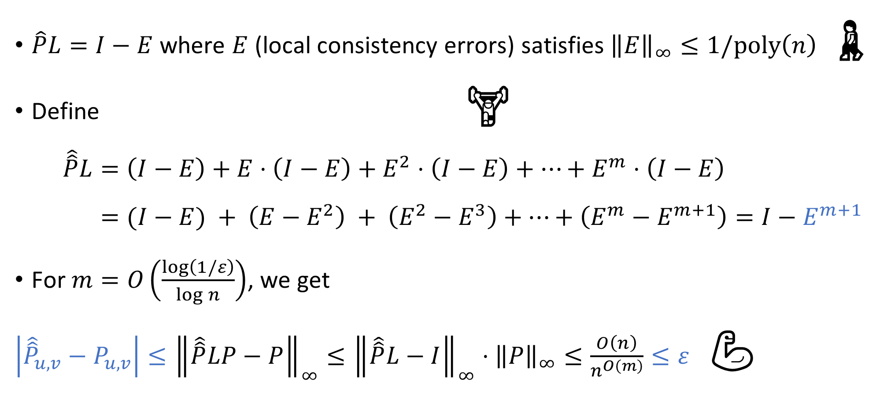
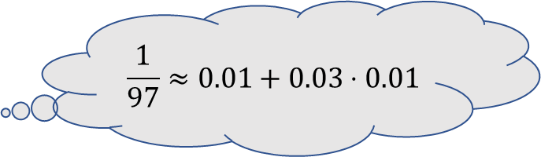
Preconditioned Richardson iteration
[Ahmadinejad, Kelner, Murtagh,
Peebles, Sidford, Vadhan 2020]
$\hat{P}L=I−E$ where $E$ (local consistency errors) satisfies ${\left\|E\right\|}_{∞}≤1/\text{poly}\left(n\right)$ 🚶
Define 🏋️
$$\hat{\hat{P}}L=\left(I−E\right)+E⋅\left(I−E\right)+E^{2}⋅\left(I−E\right)+⋯+E^{m}⋅\left(I−E\right) \\ =(I−E) + \left(E−E^{2}\right) + \left(E^{2}−E^{3}\right)+⋯+\left(E^{m}−E^{m+1}\right)=I−E^{m+1}$$
For $m=O\left(\frac{\log\left(1/ε\right)}{\log{n}}\right)$, we get
$\left|{\hat{\hat{P}}}_{u,v}−P_{u,v}\right|≤{\left\|\hat{\hat{P}}LP−P\right\|}_{∞}≤{\left\|\hat{\hat{P}}L−I\right\|}_{∞}⋅{\left\|P\right\|}_{∞}≤\frac{O\left(n\right)}{n^{O\left(m\right)}}≤ε$ 💪
$$\frac{1}{97}≈0.01+0.03⋅0.01$$
$$\hat{\hat{P}}=\hat{P}+E\hat{P}+E^{2}\hat{P}+⋯+E^{m}\hat{P}$$
Low-error approximate inverse of $L$

Slide 21
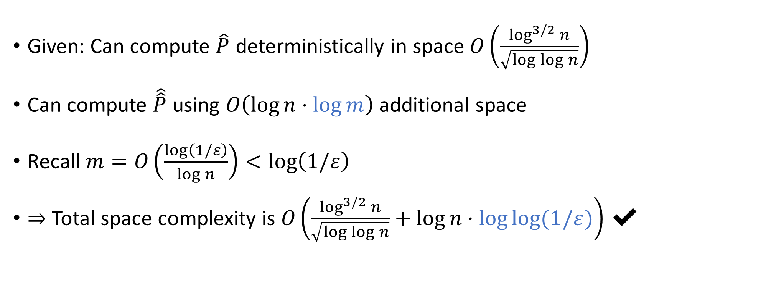

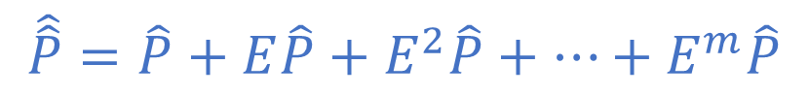
Computing $𝔼\left[f\right]±ε$ in small space
[Ahmadinejad, Kelner, Murtagh,
Peebles, Sidford, Vadhan 2020]
$$\hat{\hat{P}}=\hat{P}+E\hat{P}+E^{2}\hat{P}+⋯+E^{m}\hat{P}$$
Given: Can compute $\hat{P}$ deterministically in space $O\left(\frac{\log^{3/2}{n}}{\sqrt{\log{\log{n}}}}\right)$
Can compute $\hat{\hat{P}}$ using $O\left(\log{n}⋅\log{m}\right)$ additional space
Recall $m=O\left(\frac{\log\left(1/ε\right)}{\log{n}}\right)<\log\left(1/ε\right)$
$⇒$ Total space complexity is $O\left(\frac{\log^{3/2}{n}}{\sqrt{\log{\log{n}}}}+\log{n}⋅\log{log⁡(1/ε)}\right)$ ✔

Slide 22
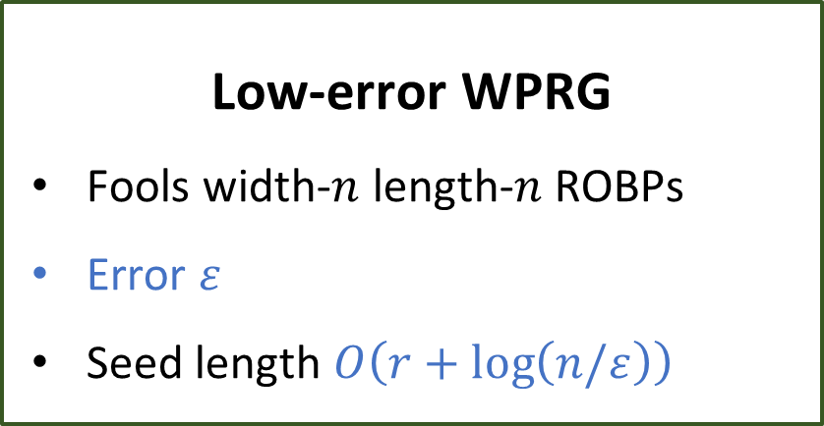
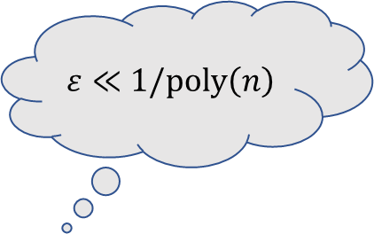
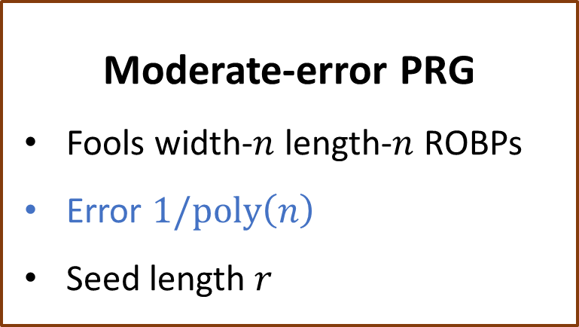


Decreasing error in the black-box setting
Theorem: $∃$ explicit WPRG for width-$n$ length-$n$ ROBPs with seed length
$$O\left(\log^{2}{n}+\log\left(1/ε\right)\right)$$
$$ε≪1/\text{poly}\left(n\right)$$
Based on a generic reduction:
Plug in Nisan’s PRG to complete proof of theorem
Moderate-error PRG
Fools width-$n$ length-$n$ ROBPs
Error $1/\text{poly}\left(n\right)$
Seed length $r$
Low-error WPRG
Fools width-$n$ length-$n$ ROBPs
Error $ε$
Seed length $O\left(r+\log\left(n/ε\right)\right)$
$$⇒$$

Slide 23

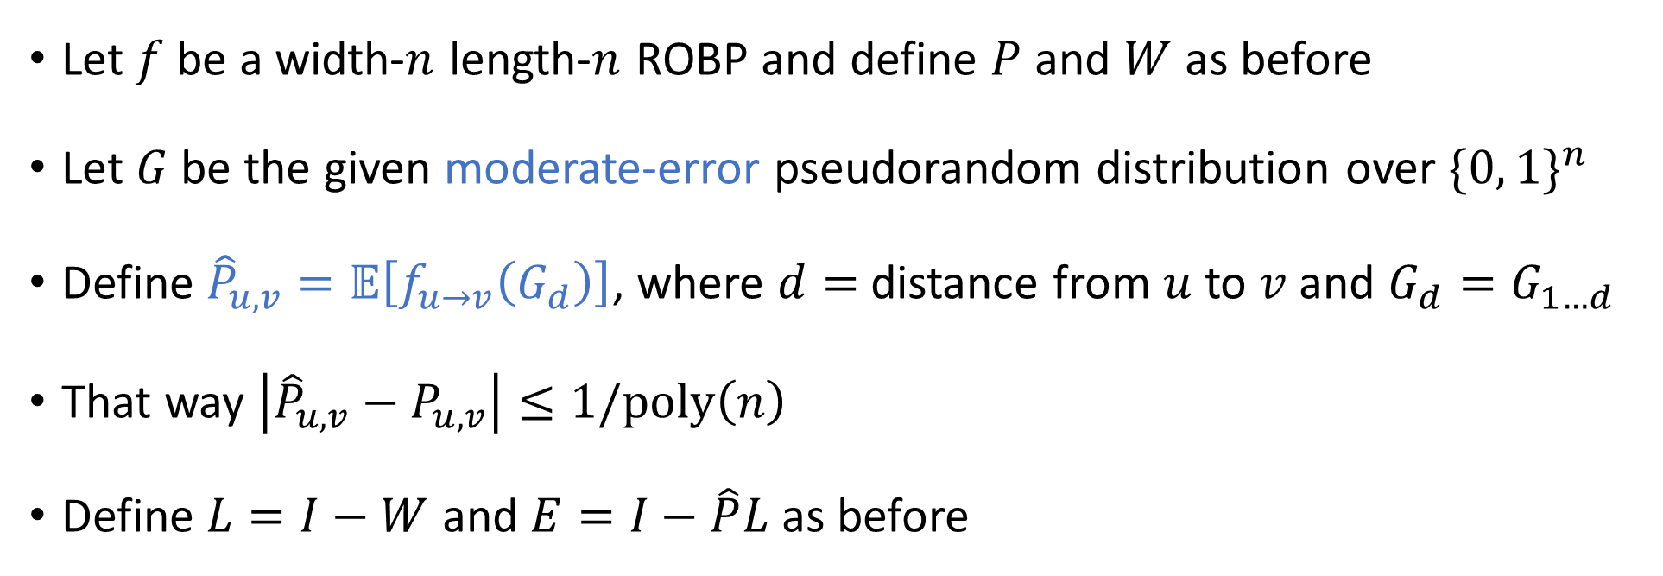
Reverse-engineering Richardson iteration 🛠
Let $f$ be a width-$n$ length-$n$ ROBP and define $P$ and $W$ as before
Let $G$ be the given moderate-error pseudorandom distribution over $\{0, 1\}^{n}$
Define ${\hat{P}}_{u,v}=𝔼\left[f_{u→v}\left(G_{d}\right)\right]$, where $d=$ distance from $u$ to $v$ and $G_{d}=G_{1…d}$
That way $\left|{\hat{P}}_{u,v}−P_{u,v}\right|≤1/\text{poly}\left(n\right)$
Define $L=I−W$ and $E=I−\hat{P}L$ as before
Plan: Design pseudodistribution s.t. “ $\hat{\hat{P}}=\hat{P}+E\hat{P}+⋯+E^{m}\hat{P}$ ” happens in the analysis [Cohen, Doron, Renard, Sberlo, Ta-Shma 2021] and [Pyne, Vadhan 2021]

Slide 24
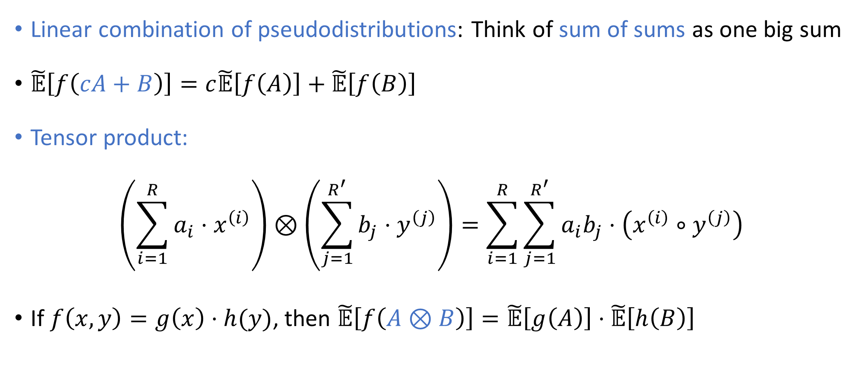
Operations on pseudodistributions
Linear combination of pseudodistributions: Think of sum of sums as one big sum
$\tilde{𝔼}\left[f\left(cA+B\right)\right]=c\tilde{𝔼}\left[f\left(A\right)\right]+\tilde{𝔼}\left[f\left(B\right)\right]$
Tensor product:
$$\left(\sum_{i=1}^{R}{a_{i}⋅x^{\left(i\right)}}\right)⊗\left(\sum_{j=1}^{R^{′}}{b_{j}⋅y^{\left(j\right)}}\right)=\sum_{i=1}^{R}{\sum_{j=1}^{R^{′}}{a_{i}b_{j}⋅\left(x^{\left(i\right)}∘y^{\left(j\right)}\right)}}$$
If $f\left(x, y\right)=g\left(x\right)⋅h(y)$, then $\tilde{𝔼}\left[f\left(A⊗B\right)\right]=\tilde{𝔼}\left[g\left(A\right)\right]⋅\tilde{𝔼}\left[h\left(B\right)\right]$
String concatenation

Slide 25
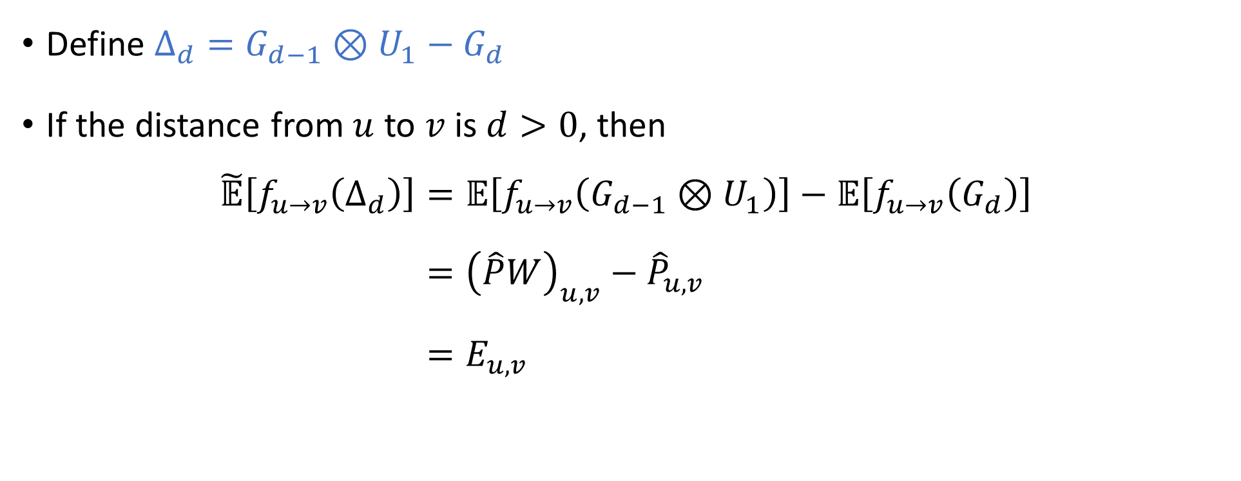
Reverse-engineering local consistency errors
Plan: Design pseudodistribution s.t. “ $\hat{\hat{P}}=\hat{P}+E\hat{P}+⋯+E^{m}\hat{P}$ ” happens in the analysis
[Cohen, Doron, Renard, Sberlo, Ta-Shma 2021] [Pyne, Vadhan 2021]
Define $Δ_{d}=G_{d−1}⊗U_{1}−G_{d}$
If the distance from $u$ to $v$ is $d>0$, then
$$\tilde{𝔼}\left[f_{u→v}\left(Δ_{d}\right)\right]=𝔼\left[f_{u→v}\left(G_{d−1}⊗U_{1}\right)\right]−𝔼\left[f_{u→v}\left(G_{d}\right)\right] \\ ={\left(\hat{P}W\right)}_{u,v}−{\hat{P}}_{u,v} \\ =E_{u,v}$$
✔

Slide 26
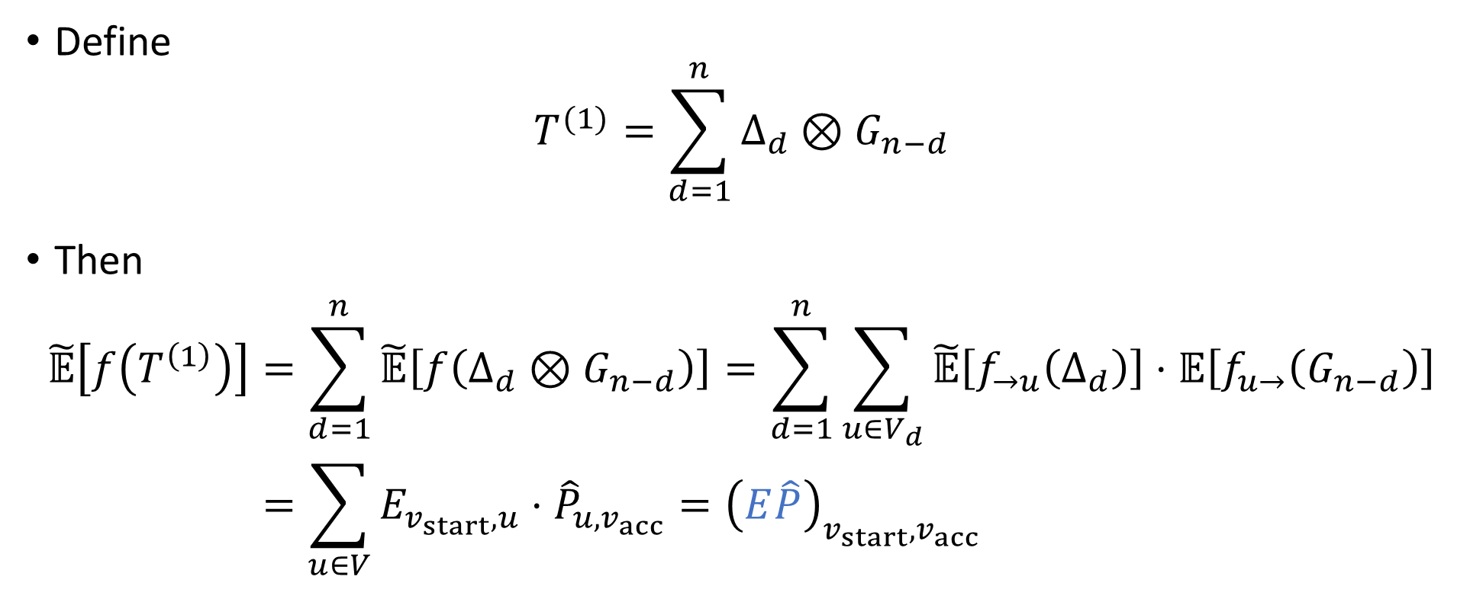
The first correction term
Plan: Design pseudodistribution s.t. “ $\hat{\hat{P}}=\hat{P}+E\hat{P}+⋯+E^{m}\hat{P}$ ” happens in the analysis
[Cohen, Doron, Renard, Sberlo, Ta-Shma 2021] [Pyne, Vadhan 2021]
Define
$$T^{(1)}=\sum_{d=1}^{n}{Δ_{d}⊗G_{n−d}}$$
Then
$$\tilde{𝔼}\left[f\left(T^{\left(1\right)}\right)\right]=\sum_{d=1}^{n}{\tilde{𝔼}\left[f\left(Δ_{d}⊗G_{n−d}\right)\right]}=\sum_{d=1}^{n}{\sum_{u∈V_{d}}{\tilde{𝔼}\left[f_{→u}\left(Δ_{d}\right)\right]⋅𝔼\left[f_{u→}\left(G_{n−d}\right)\right]}} \\ =\sum_{u∈V}{E_{v_{start},u}⋅{\hat{P}}_{u,v_{acc}}}={\left(E\hat{P}\right)}_{v_{start},v_{acc}}$$
✔

Slide 27
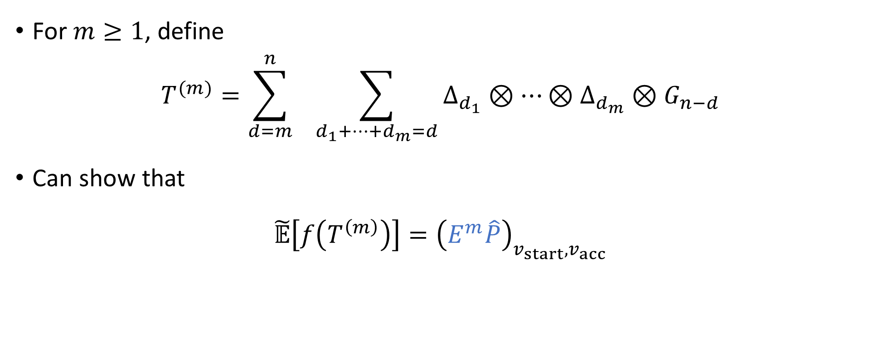
Subsequent correction terms
Plan: Design pseudodistribution s.t. “ $\hat{\hat{P}}=\hat{P}+E\hat{P}+⋯+E^{m}\hat{P}$ ” happens in the analysis
[Cohen, Doron, Renard, Sberlo, Ta-Shma 2021] [Pyne, Vadhan 2021]
For $m≥1$, define
$$T^{(m)}=\sum_{d=m}^{n}{ \sum_{d_{1}+…+d_{m}=d}{Δ_{d_{1}}⊗⋯⊗Δ_{d_{m}}⊗G_{n−d}}}$$
Can show that
$$\tilde{𝔼}\left[f\left(T^{\left(m\right)}\right)\right]={\left(E^{m}\hat{P}\right)}_{v_{start},v_{acc}}$$
✔

Slide 28
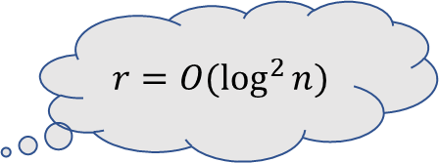
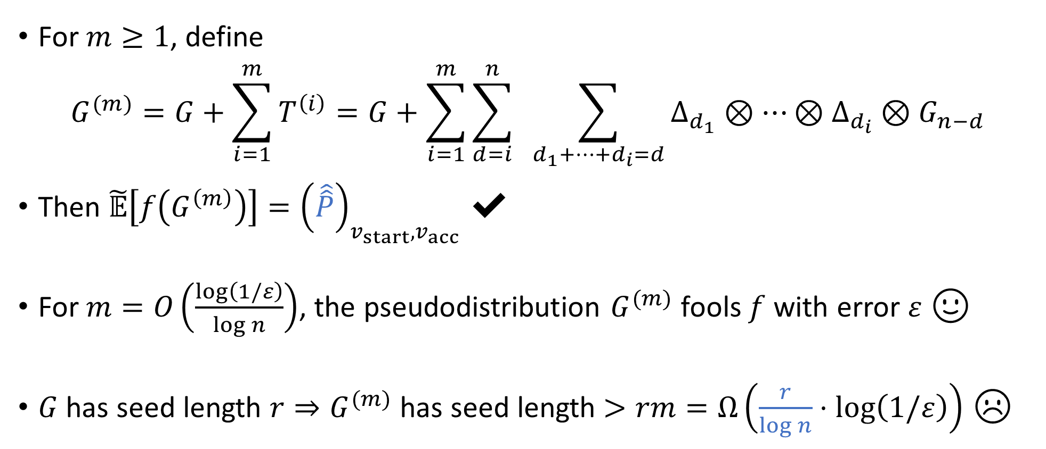
Richardson iteration for pseudodistributions
Plan: Design pseudodistribution s.t. “ $\hat{\hat{P}}=\hat{P}+E\hat{P}+⋯+E^{m}\hat{P}$ ” happens in the analysis
✔
[Cohen, Doron, Renard, Sberlo, Ta-Shma 2021] [Pyne, Vadhan 2021]
For $m≥1$, define
$$G^{(m)}=G+\sum_{i=1}^{m}{T^{\left(i\right)}}=G+\sum_{i=1}^{m}{\sum_{d=i}^{n}{ \sum_{d_{1}+…+d_{i}=d}{Δ_{d_{1}}⊗⋯⊗Δ_{d_{i}}⊗G_{n−d}}}}$$
Then $\tilde{𝔼}\left[f\left(G^{\left(m\right)}\right)\right]={\left(\hat{\hat{P}}\right)}_{v_{start},v_{acc}}$ ✔
For $m=O\left(\frac{\log\left(1/ε\right)}{\log{n}}\right)$, the pseudodistribution $G^{(m)}$ fools $f$ with error $ε$ 🙂
$G$ has seed length $r⇒G^{(m)}$ has seed length $>rm=Ω\left(\frac{r}{\log{n}}⋅\log\left(1/ε\right)\right)$ ☹
$$r=O(\log^{2}{n})$$

Slide 29
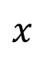
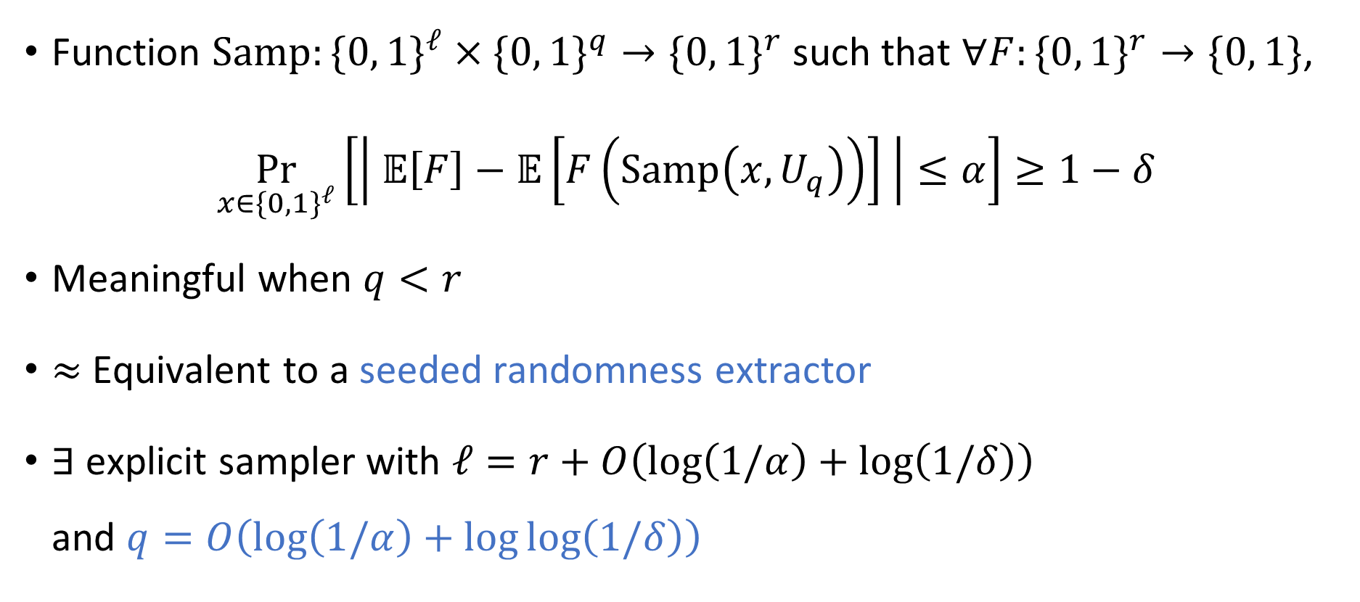

Tool for improving seed length: Sampler
Function $\text{Samp}:\{0, 1\}^{ℓ}×\{0, 1\}^{q}→\{0, 1\}^{r}$ such that $∀F:\{0, 1\}^{r}→\{0, 1\}$,
$$\underset{x∈\{0, 1\}^{ℓ}}{Pr}\left[\left| 𝔼\left[F\right]−𝔼\left[F\left(\text{Samp}\left(x,U_{q}\right)\right)\right] \right|≤α\right]≥1−δ$$
Meaningful when $q<r$
$≈$ Equivalent to a seeded randomness extractor
$∃$ explicit sampler with $ℓ=r+O\left(\log\left(1/α\right)+\log\left(1/δ\right)\right)$ and $q=O\left(\log\left(1/α\right)+\log{\log\left(1/δ\right)}\right)$
$$x$$
$$F$$

Slide 30


A family of log-seed PRGs, most of which work
$$r=O(\log^{2}{n})$$
Let $G$ be moderate-error PRG with seed length $r$
Let $\text{Samp}:\{0, 1\}^{O\left(r+\log\left(1/ε\right)\right)}×\{0, 1\}^{O(\log{n})}→\{0, 1\}^{r}$ be a sampler
For each $x$, define $G_{x}\left(y\right)=G\left(\text{Samp}\left(x, y\right)\right)$, so $G_{x}$ has seed length $O\left(\log{n}\right)$
Fact: $∀$ width-$n$ length-$n$ ROBP $f$, w.h.p. over $x$, $G_{x}$ fools $f$ with moderate error
More generally, w.h.p. over $x$, the PRG $G_{x}$ fools all subprograms $f_{u→v}$
(Union bound)

Slide 31


♻ Using sampler to recycle seeds
“Pick $x$ at random, then apply preconditioned Richardson iteration to $G_{x}$”
Final pseudodistribution: $G^{′}=2^{−ℓ}\sum_{x}{G_{x}^{\left(m\right)}}$
For $(1−ε)$-fraction of $x$, the PRG $G_{x}$ fools all subprograms of $f$ with error $1/\text{poly}(n)$, which is sufficient to ensure that $G_{x}^{(m)}$ fools $f$ with error $ε$
$G_{x}$ has seed length $O\left(\log{n}\right)⇒G_{x}^{(m)}$ has seed length $O\left(\log\left(n/ε\right)\right)$
Sampling $x$ costs $O\left(r+\log\left(1/ε\right)\right)$ additional truly random bits ✔

Slide 32



Application of WPRGs: Beating Saks-Zhou
Theorem: $∀S=S\left(n\right)≥\log{n}$, $\text{BPSPACE}(S)⊆\text{DSPACE}\left(S^{3/2}/\sqrt{\log{S}}\right)$
Starting point: Derandomization framework of [Saks-Zhou 1995, Armoni 1998]
PRG for short, wide ROBPs with error $1/\text{poly}\left(w\right)$
Derandomization of $\text{BPSPACE}$
$$⇒$$

Slide 33

PRGs for short, wide ROBPs: State of the art
Nisan’s PRG has seed length $O\left(\log\left(wn/ε\right)\log{n}\right)$
[Armoni 1998]: When $n≪w$, it is possible* to beat Nisan’s PRG by a factor of $Θ\left(\log{\log{w}}\right)$ 😃
*Only works for large $ε$ such as $1/\text{poly}\left(n\right)$. No improvement for $ε=1/\text{poly}\left(w\right)$ ☹

Slide 34





New WPRG-based derandomization
[Armoni 1998] (slightly better than Nisan)
Seed length is still slightly better than Nisan’s PRG
Space complexity slightly better than Saks-Zhou
PRG for short, wide ROBPs with error $1/\text{poly}\left(n\right)$
WPRG for short, wide ROBPs with error $1/\text{poly}\left(w\right)$
Derandomization of $\text{BPSPACE}$
$$⇒$$
$$⇒$$
Reduction presented earlier, or alternative reduction by [CDRSTS 2021, PV 2021]
Today’s error reduction procedure, or alternatively, prior procedure by [CDRSTS 2021, PV 2021]
Reduction presented earlier, or alternative reduction by [CDRSTS 2021, PV 2021]
Generalization of Saks-Zhou framework for WPRGs by [Chattopadhyay, Liao 2020]

Slide 35


Concluding comments: PRGs vs. WPRGs vs. HSGs
WPRGs are easier to construct than unweighted PRGs
Today: Best known WPRGs better than best known PRGs
In another setting, there is an inherent gap! $∃$ WPRG with seed length $\tilde{O}\left(\log^{3/2}{n}\right)$, but $∀$ PRG, seed length is $Ω\left(\log^{2}{n}\right)$ [Pyne, Vadhan 2021] [H, Pyne, Vadhan 2021]
At the same time, WPRGs are more useful than HSGs
Can combine WPRGs with Saks-Zhou framework
Open problem: Combine HSGs with Saks-Zhou framework

Slide 36

More open problems
Optimal WPRGs for “Nisan-Zuckerman” regime?
WPRGs for ROBPs of width $w$ and length $\text{polylog}(w)$ with seed length $O\left(\log\left(w/ε\right)\right)$?
Is low error the only advantage of WPRGs over PRGs?
Can we generically convert any $ε$-WPRG into a $0.1$-PRG with a similar seed length?
More applications of WPRGs?
$\text{BPL}⊆\text{DTISP}\left(\text{poly}\left(n\right), o\left(\log^{2}{n}\right)\right)$?
Thanks! Questions?

